Slide 1


How many COVID-19 tests were conducted worldwide in May, June, July 2020, and 2023, and how many were vaccinated till 18 January 2023 worldwide? Payal Vaidya fall 2023

Slide 2

Introduction and Background
The SARS-CoV-2 virus is the source of COVID-19, also known as Coronavirus Disease 2019. It is a highly contagious respiratory infection. ( Platto, S., Wang, Y., Zhou, J., & Carafoli, E. (2021, January 29))
From its initial discovery in Wuhan, China, towards the end of 2019, the virus has spread over the world and become a pandemic
Frequent signs and symptoms include fever, coughing, and dyspnea; respiratory droplets are the main way that the virus spreads
Global public health measures have been implemented because of the pandemic's enormous effects on health, society, and the economy
I chose the dataset COVID-19- the number of individuals who tested positive worldwide during May, June, and July 2020, and 2023
Third dataset of COVID-19 Give vaccinations till 18 January 2023 worldwide

Slide 3
Global public health measures have been implemented because of the pandemic's enormous effects on health, society, and the economy. The coronavirus epidemic has caused a crisis that is affecting every aspect of existence. To stop the pandemic and prevent coronavirus infection, vaccinations against the virus have been created. Since preventing and halting the spread of the coronavirus may only be possible through vaccinations.( Biswas, Md. R., Alzubaidi, M. S., Shah, U., Abd-Alrazaq, A. A., & Shah, Z. (2021, October 25))

Slide 4

Introduction and Background
I am motivated by this topic because everyday millions of COVID-19 tests are conducted in each country and many of them come out positive even after being vaccinated
It has an impact on every part of the world
With the help of a visualization project, we can improve our understanding of positive cases, conducted cases, and Given Vaccinations worldwide
It improves public health management helps to track COVID-19-positive cases and aids in Isolation in the phase of covid
I was inspired by (Filchakova, O., Dossym, D., Ilyas, A., Kuanysheva, T., Abdizhamil, A., & Bukasov, R. (2022)) ) articles
According to this dataset we have COVID-19 vaccination data till 18 January
Covid-19 test tracking and the collection of vaccines have become crucial parts of the fight against COVID

Slide 5

Objectives and goals
The most promising hope for ending the pandemic is an effective launch of COVID-19 vaccines
A vaccination is designed to protect against COVID
It requires a defined purpose and policy based on the best available evidence, universal case definitions, and nationwide consistency in testing criteria
It requires clarification regarding who is qualified for testing and who is responsible for communicating, interpreting, and acting on test results

Slide 6

Objectives and goals
My primary goal is to provide a better understanding of COVID-19 conducted tests and positive cases which help society to be aware of the situation it includes details about positive cases, date of conducted and positive cases, conducted testing count, total vaccination dose administered by country, % of fully vaccinated populations, country, and source of information
I want to learn how rapidly COVID-19 spread in each country and how vaccination controls the COVID-19 count and gives protection globally

Slide 7

Questions
How Many COVID-19 Positive cases per million in May, June, and July 2020
Which are the Top 5 Countries affected by most COVID-19 Positive Cases Worldwide in May, June, and July 2020?
How Many % of the population fully COVID-19 vaccinated in Each Country before 18 January 2023?
How many COVID-19 Vaccine Doses/Millions Before 18 January 2023 Worldwide?
How many % of the Population was Fully Vaccinated by the COVID-19 vaccine till January 18, 2023, and how many Positive tests of COVID-19 Worldwide?
What is the global daily conducted of COVID-19 cases throughout May, June, and July 2023 after being Vaccinated?
Comparison of COVID-19 Positive cases per million for May, June, and July in both 2020 and 2023

Slide 8

Benefits
It can increase awareness about testing and control of spreading viral infection by knowing positive cases
Vaccination datasets give us a better understanding of How many people are Vaccinated until January 18, 2023
With the benefits of vaccination increase the rate of vaccination
Understanding immunization rates and COVID-19 test-positive counts are essential for
Real-time Assessment: Tracking the pandemic's current situation
Resource Allocation: Providing effective deployment of healthcare resources
Public Awareness: Promoting immunizations and safety precautions
Making policy decisions: guiding governmental actions and limitations
International cooperation: guiding nations in their attempts to control the epidemic

Slide 9
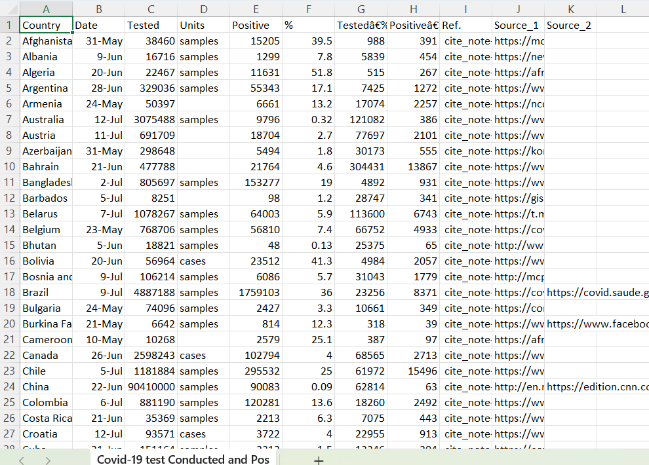
Three Datasets Description
The first dataset
It is about COVID-19 tests conducted and positive cases in May, June, and July 2020
This dataset has COVID-19 tests conducted and positive worldwide and has information about many sources for each county from where the dataset was found
It explains tested/million as well as positive/million
It includes a month of COVID-19 tests conducted and COVID-19 positive tests worldwide
It has a unit that includes samples and cases
With the dates and country, we can visualize the data that which county has had COVID-19 tests conducted and positive.

Slide 10
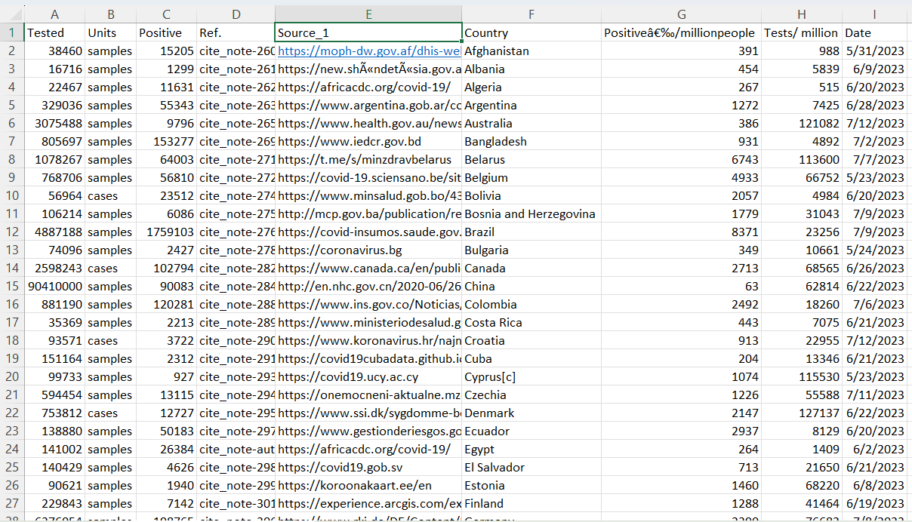
Second Dataset
It is about COVID-19 tests conducted and positive cases in May, June, and July 2023
It includes a month of COVID-19 tests conducted and COVID-19 positive tests worldwide
It has a unit that includes samples and cases
This dataset has COVID-19 tested, positive worldwide and has information about many sources for each county from where the dataset was found
It explains tested/million as well as positive/million

Slide 11
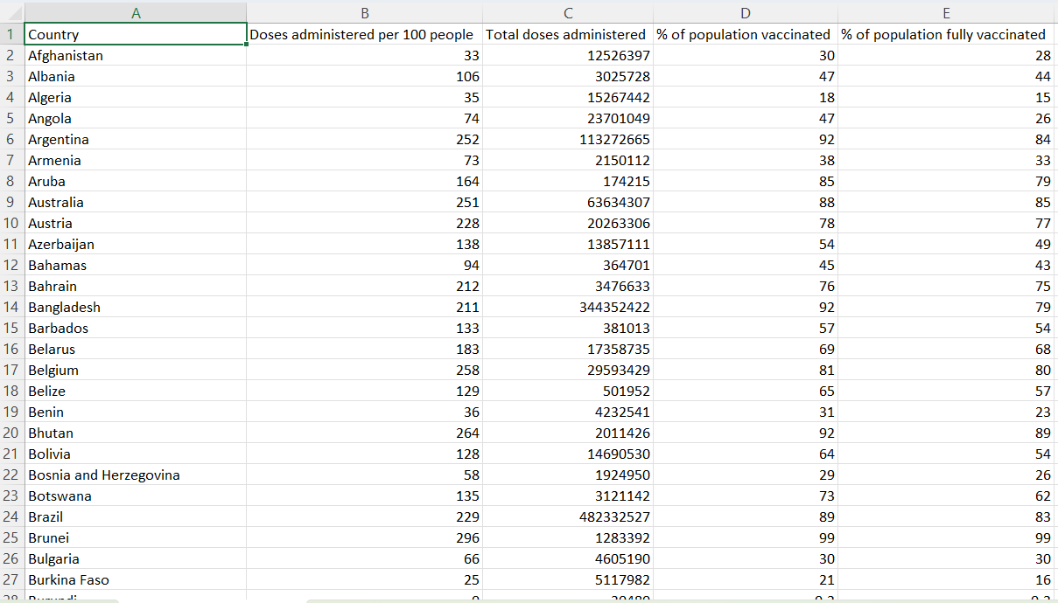
The Third dataset
Is Worldwide Vaccination data Worldwide
The COVID-19 vaccine is being offered by countries all over the world
It has included a country with a percentage of fully immunized people
It includes a dose for every 100 people
We may develop a visualization of vaccinated countries with the help of this dataset
With the overall amount of COVID-19 vaccination administered to each country, we may conclude that this large population will be protected from COVID-19 in the future

Slide 12

Why was the data created, and for what purpose?
The purpose of collecting both datasets of COVID-19 tests conducted and positive case results from May, June, and July 2020 and 2023 is to gain improved awareness of how many people are positive so we can isolate them, distance themselves from others, seek better treatment, and control the spread of infection globally
Using Visualization, create a graph with the Worldwide Vaccination third dataset
We can raise awareness about how many individuals have been vaccinated and are safe from this disease, which will inspire others to be vaccinated to protect themselves and others during this critical pandemic situation

Slide 13

What is the timeline or lineage of the data?
The two datasets of COVID-19 evaluation Conducted and positive cases in May, June, and July 2020 and 2023 worldwide both datasets have the timeline of May, June, and July 2020 and 2023
which explains how many covid-19 conducted and tested during the 3 months of both years 2020 and 2023 and the third dataset of COVID-19 vaccinations given in each country till 18 January 2023 worldwide
Where we can see the vaccinated people before 18 January 2023

Slide 14

How large is the dataset ?
These are a huge dataset that has multiple variables and cases of each country
This dataset gives us a better understanding of the worldwide data of the tests conducted and positive and people vaccinated with the different variables.

Slide 15

How large is the dataset ?
First dataset of Covid-19 Conducted Cases and positive cases during May, June, and July 2020 has Variables
Date
Country
Tested
Positive
Tested/Million
Positive/Million
Reference
Source

Slide 16
How large is the dataset ?
The second dataset of COVID-19 conducted Cases and positive cases during May, June, and July 2023 has Variables
Date
Country
Tested
Positive
Tested/Million
Positive/Million
Reference
Source

Slide 17
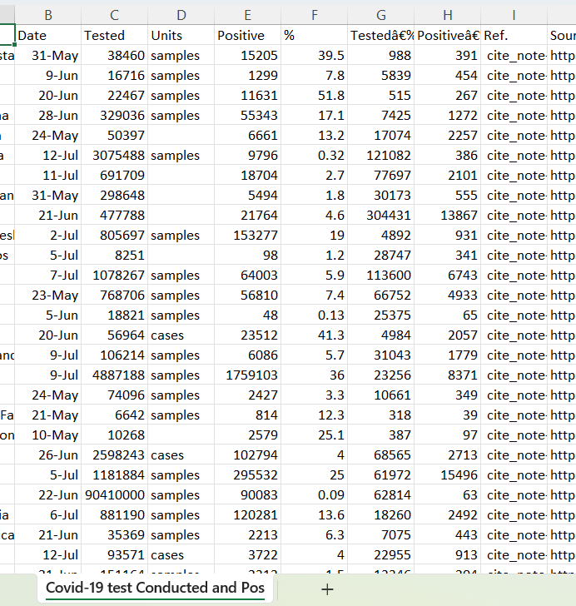
How large is the dataset ?
The third dataset of COVID-19 vaccinations given in each country till 18 January 2023 worldwide
Total dose administered
Country
Vaccination Dose 100 per population
% of populations vaccinated
% of populations fully vaccinated

Slide 18

What locations are included in the dataset?
All three datasets include each country of the world as a location
It explains the data of vaccinated people worldwide and tests conducted and positive worldwide
Some countries have the highest number of COVID-19 tests positive, and some countries have the lowest rate of COVID-19 vaccination
It depends on how many people are taking vaccination doses as well as how many tests are conducted by the country during the 3 months of 2020, and 2023

Slide 19

How will the datasets help you achieve your goals/questions posed in your introduction? Are there any limitations in the datasets?
With the help of these three datasets, we can create a graph of how many people COVID-19 tested positive during May, June, and July 2020, and 2023
And the rate of COVID-19 vaccinated population in each country before 18 January
We can create world-level Maps, Bar, Line, Circle, Side by side, and Table graphs with the help of different variables of these three datasets and we can visualize our questions and get answers with the help of graphs.
All three datasets have some missing data as a limitation, so that is the reason we are unable to visualize some country's data with the help of graphs

Slide 20
Who Collected the Data? and Who funded the project that the data came from
The Data on COVID-19 tests conducted and positive cases in May, June, and July 2023 worldwide is collected by each country from different source websites we can see in our dataset that this project is funded by Skyland from this different source as our data world as an open-source data. (SkyLord. (2020a, July 13))
Other data of the latest vaccination worldwide till 18 January 2023 data is collected by Josh holder and the project funded by the Ananthan h from the New York Times and posted on the Kaggle website. (josh_Holder. (2023))

Slide 21
Data Story
Explanations of seven Graphs with the help of variables from both datasets of COVID-19 tests conducted and positive during May, June, and July 2020 and 2023
And third dataset of COVID-19 vaccination given by country before 18 January 2023
We can create a Map chart, bar chart, Line Chart, Table chart, Circle Graph, and side-by-side chart
Here we have enough datasets and variables to create 6 visualization graphs and we can see how it works

Slide 22

1. How Many COVID-19 Positive cases per million in May, June, and July 2020
Using the first dataset of COVID-19 cases Conducted and positive during May, June, and July 2020
I created a line graph and selected two variables
The first Variable is the date (Day (Date)), which is discrete. (Temporal Variable) (Numeric Variable)
The second Variable of positive per million (Measure (sum)), which is continuous. (Rate Variable)

Slide 23
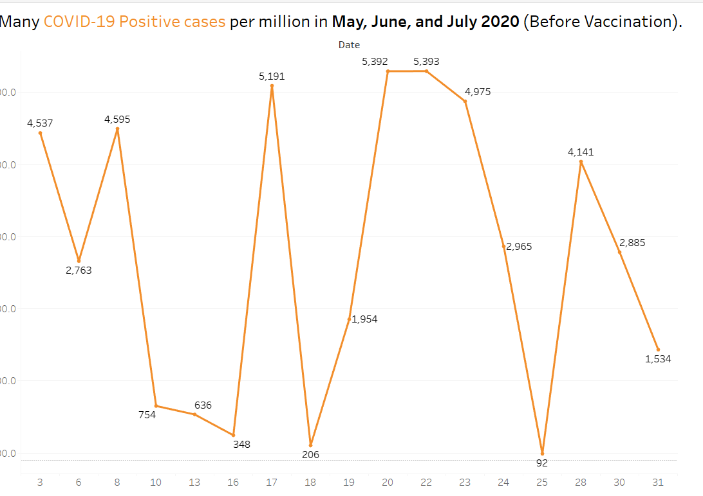
1. How Many COVID-19 Positive cases per million in May, June, and July 2020
The line graph shows how the number of COVID-19-positive cases per million individuals varied in May, June, and July of 2020—a period before the mass immunization campaigns
The graph's highs and lows show variations in infection rates and provide information on the pandemic's dynamics and intensity before the development of vaccines
Informed decision-making for upcoming public health initiatives is aided by this graphic portrayal, which is a useful tool for understanding the impact of the virus during these crucial months on a per-million-population basis

Slide 24
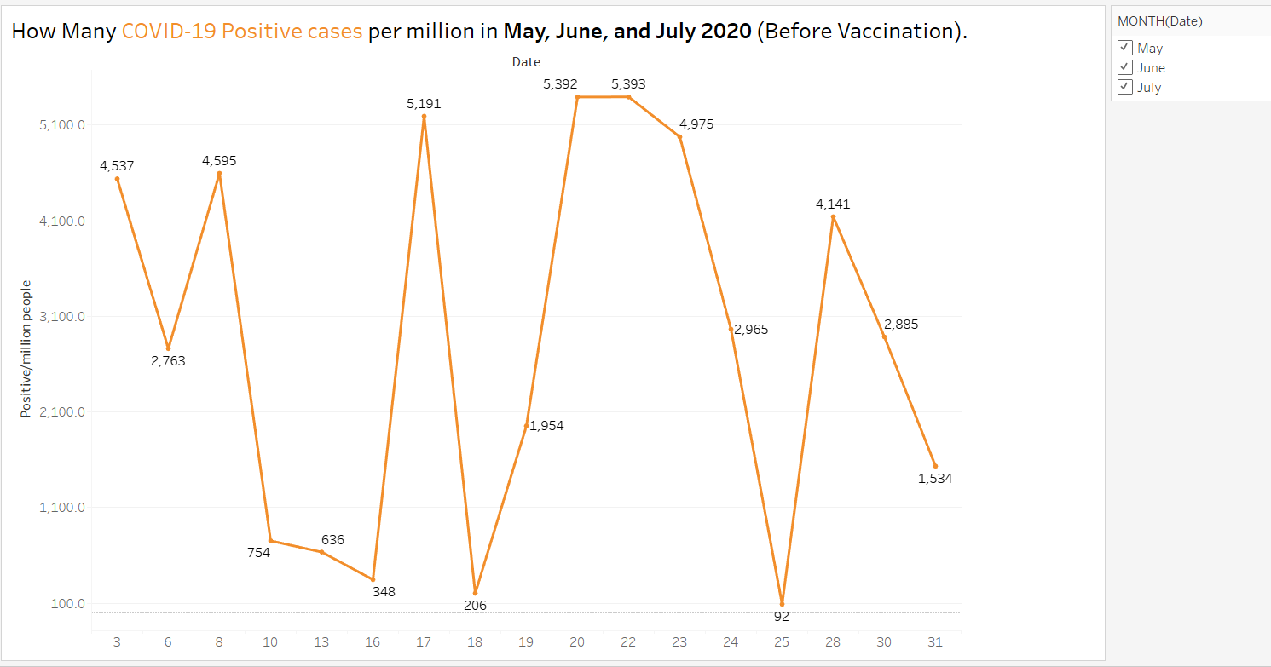

Slide 25
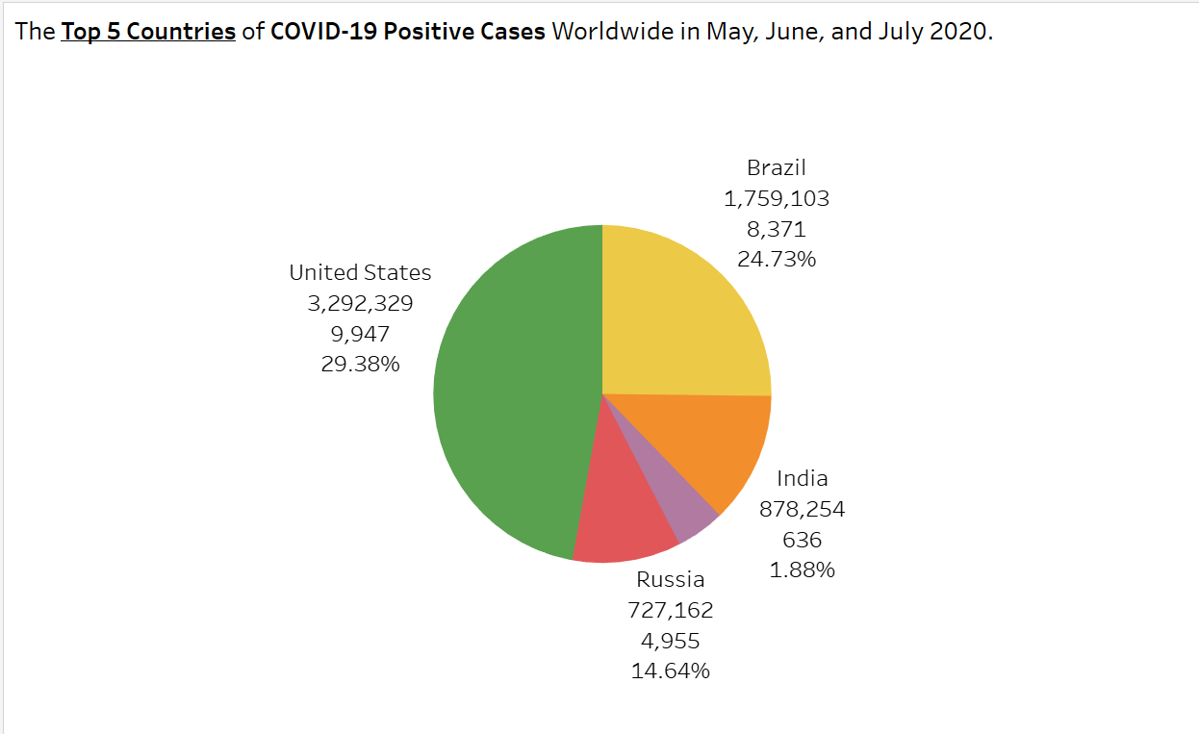
The Top 5 Countries of COVID-19 Positive Cases Worldwide in May, June, and July 2020
The first COVID-19 case dataset was conducted in May, June, and July 2020, and provided positive results
I made a pie chart for the top 5 countries with positive COVID-19 cases and used the following variables
The distribution of COVID-19-positive cases during May, June, and July 2020 among the top five countries—the United States, Brazil, India, Russia, and Peru—is shown graphically in the pie chart
The first variable is a categorical variable called "Country (Dimensions)." In May, June, and July of 2020, I generated a field containing the top five COVID-19-positive cases.
The (continuous) second positive variable is measure (sum). Numerically variable.
The (continuous) third variable is positive/Million (Measure (sum)). Rate Variable.

Slide 26
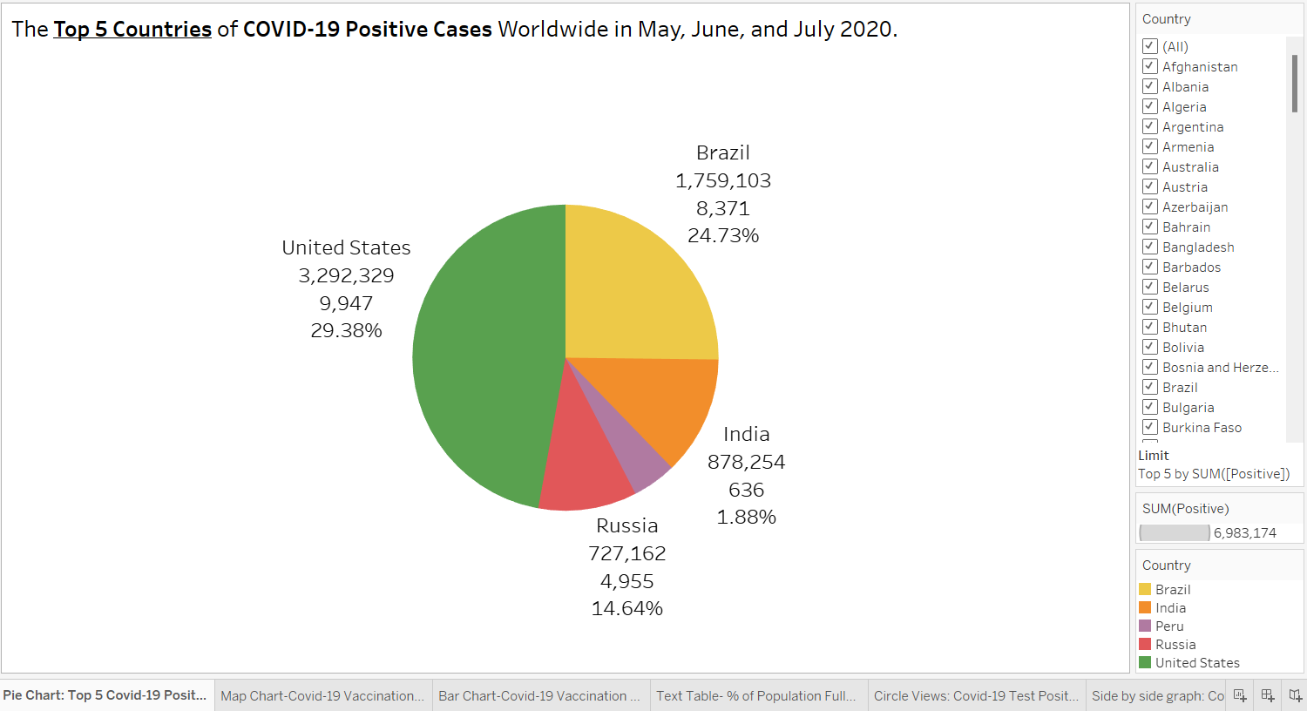

Slide 27
The Top 5 Countries of COVID-19 Positive Cases Worldwide in May, June, and July 2020
This graphic provides a comparative overview of the pandemic's effects using data for total cases and percentages per million people
The size of each slice indicates the number of cases per million, and each slice represents a nation
This clear graphic helps clarify the relative influence of each of the top five countries, directing the conversation on regional inequalities and providing guidance for focused solutions

Slide 28
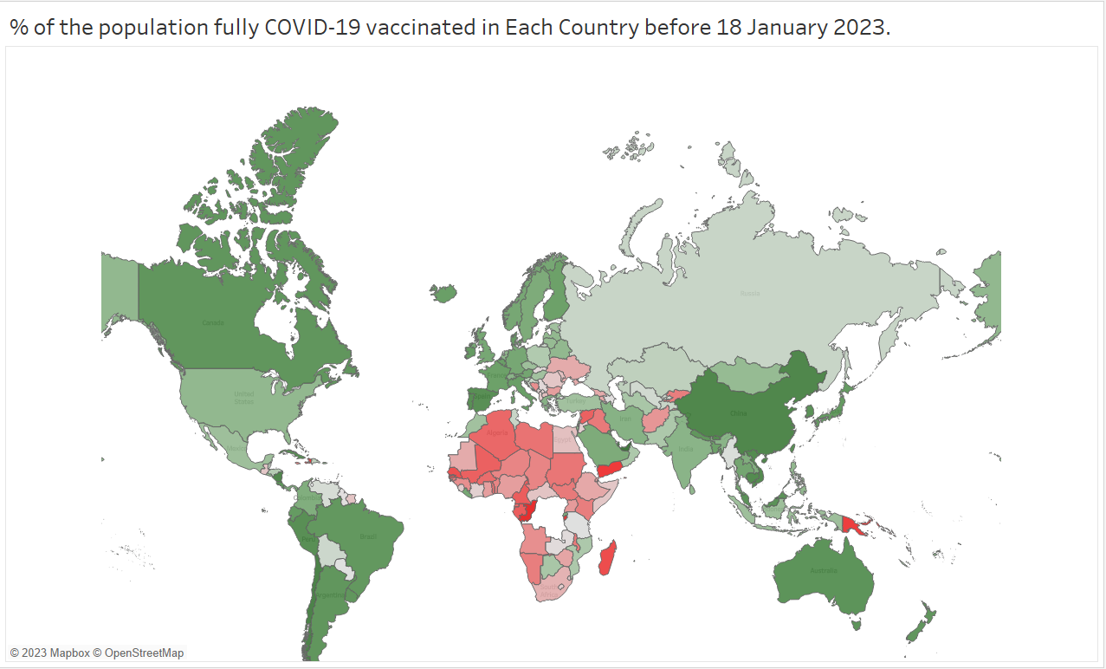
% of the population fully COVID-19 vaccinated in Each Country before 18 January 2023
Using the third dataset of Worldwide Vaccination data Worldwide
I created a map graph and selected two variables
The first Variable is the % of the population fully vaccinated (Measure (Sum)), (Continuous) Rate Variable
Created Calculation Field: Sum (% of population fully Vaccinated)
The second Variable of County (Dimension). Is a categorical Variable.
The map graph shows the proportion of each country's population that was fully immunized against COVID-19 before January 18 2023
The green color indicates higher vaccination rates and provides a brief overview of the world's vaccination efforts and the red color for low vaccination rates and highlights places that could need more assistance

Slide 29
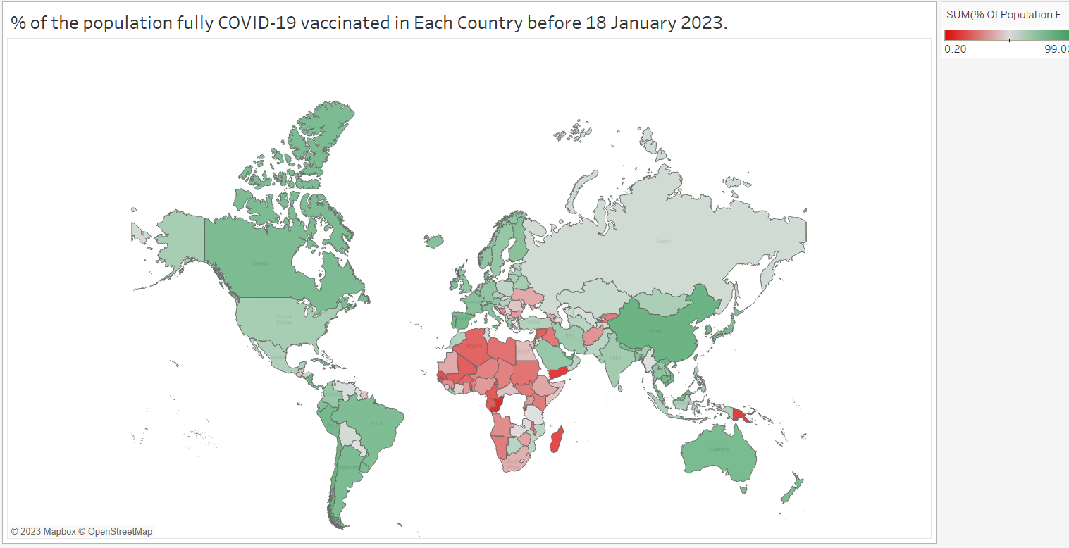

Slide 30
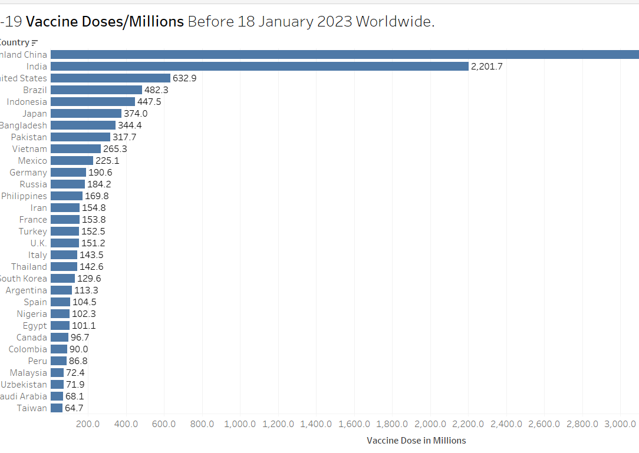
COVID-19 Vaccine Doses/Millions Before 18 January 2023 Worldwide
Using the third dataset of Worldwide Vaccination data.
I created a horizontal bar graph and selected two variables
The first Variable is the Vaccine Doses/Millions (Measure (Sum)), (Continuous), Numerical Variable
The second Variable of County (Dimension). Is a categorical Variable.
The number of COVID-19 vaccine doses given per million individuals in each nation before January 18, 2023, appears in a horizontal bar graph
A clear and informative overview of global vaccination efforts is provided by longer bars, which indicate higher immunization rates

Slide 31
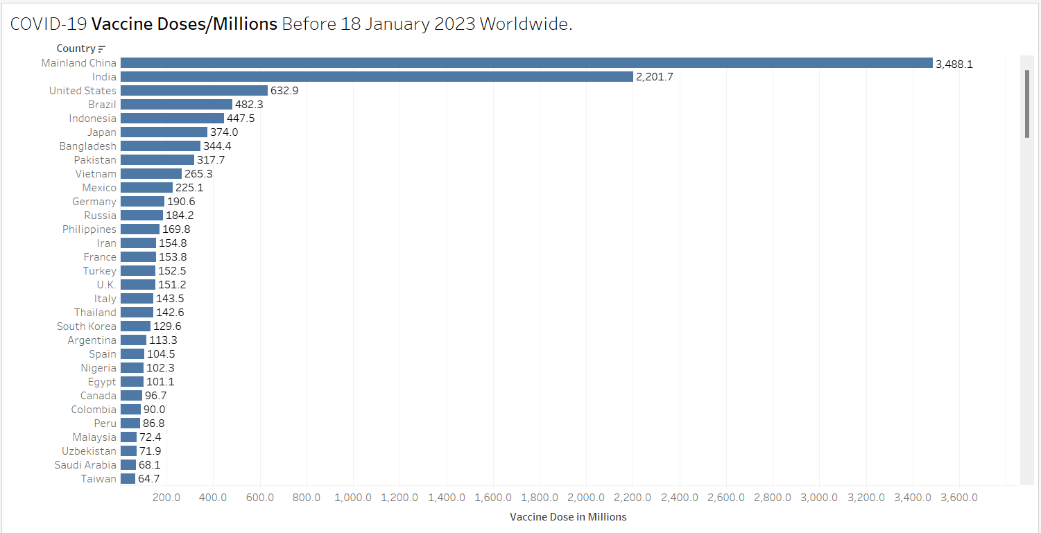

Slide 32
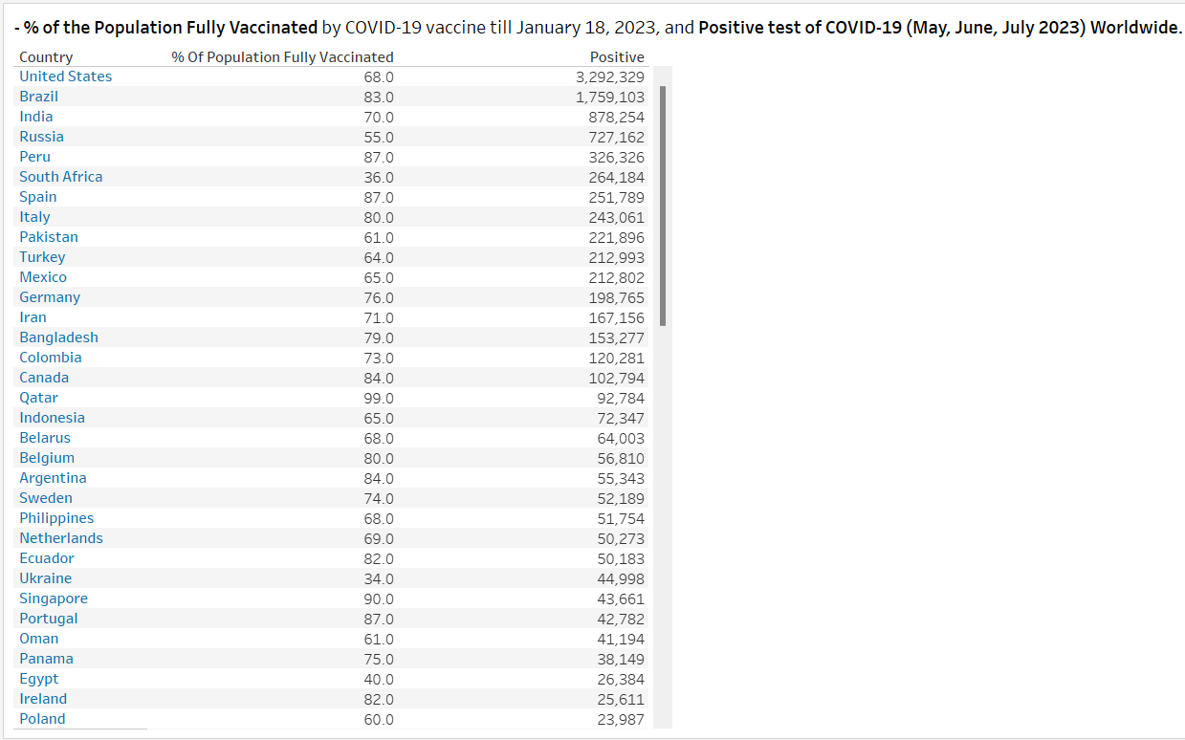
- % of the Population Fully Vaccinated by COVID-19 vaccine till January 18, 2023, and Positive test of COVID-19 Worldwide
Using the third dataset of Worldwide Vaccination data Worldwide
I created a Text table graph and selected three variables.
The first Variable is the % of the population fully vaccinated (Measure (Sum)) Rate Variable.
The second Variable of County (Dimension). Is a categorical Variable.
The Third Variable of Positive (Measure (Sum)) Numerical Variable.
Two crucial factors are included in the text table graph: % of the population Fully immunized against COVID-19 by January 18, 2023, and the number of positive cases in May, June, and July of the same year
It is possible to quickly compare the rates of infection and vaccination success by selecting a country from each row.

Slide 33
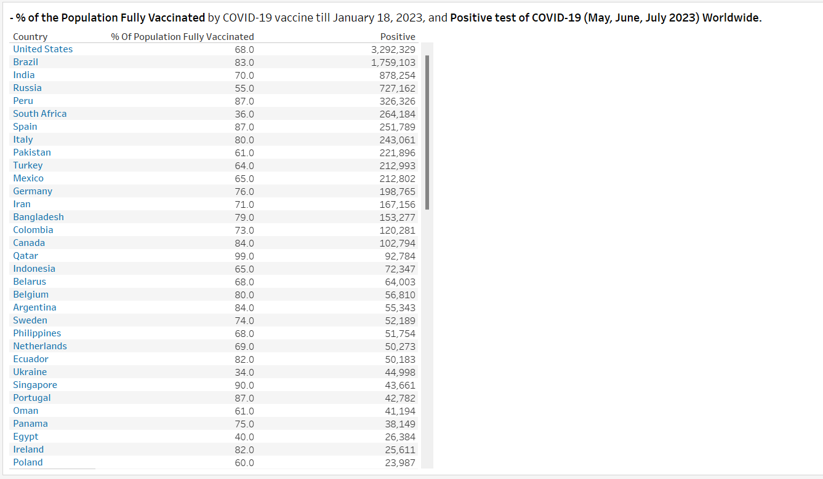

Slide 34
- % of the Population Fully Vaccinated by COVID-19 vaccine till January 18, 2023, and Positive test of COVID-19 Worldwide
This concise visual provides insights on the dynamics of COVID-19 globally, helping in the identification of areas that may benefit from stronger health programs as well as those where vaccination efforts have been successful in preventing transmission

Slide 35
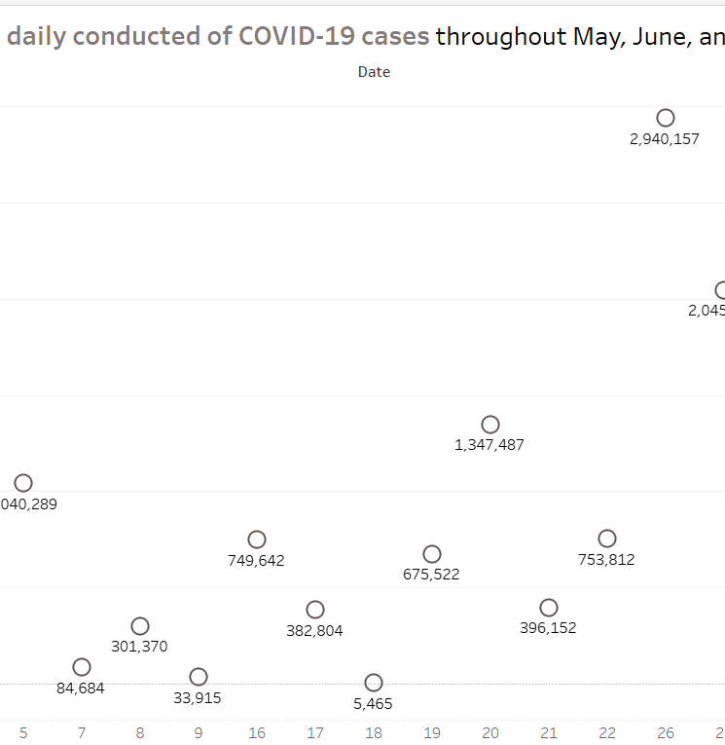
What is the global daily conducted of COVID-19 cases throughout May, June, and July 2023?
Using the second dataset of COVID-19 cases Conducted and positive during May, June, and July 2023
I created a Circle graph and selected two variables
The first Variable is the date (Day (Date)), which is discrete. (Temporal Variable) (Numeric Variable)
The second Variable test (Measure (sum)), which is continuous. (Numeric Variable)
The circle graph shows the daily COVID-19 cases that were conducted globally in May, June, and July of 2023
Daily case numbers are indicated by the place of each circle, which represents a day
The graph's highs and lows highlight patterns and allow viewers to rapidly understand the dynamics of the pandemic

Slide 36
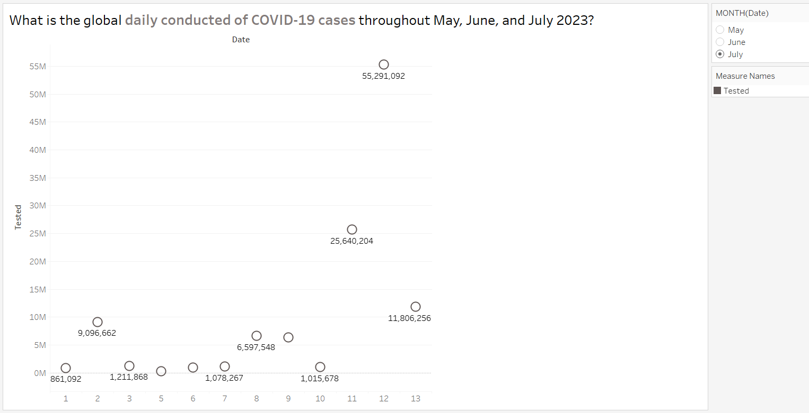

Slide 37
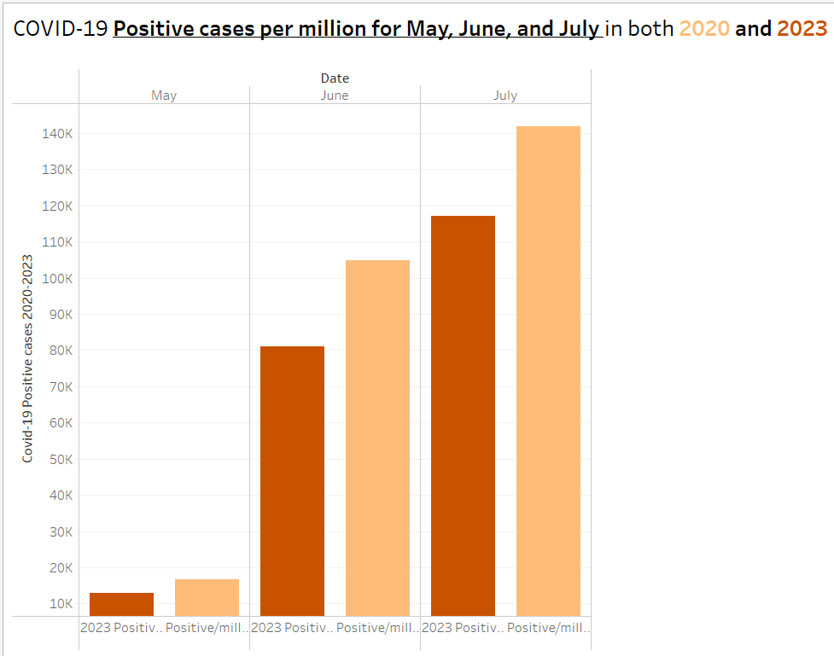
7. COVID-19 Positive cases per million for May, June, and July in both 2020 and 2023
I created a Side-by-Side graph and selected two variables from two different Datasets
Using the first dataset of COVID-19 cases Conducted and positive during May, June, and July 2020,
The First Variable of positive/Million people (Measure (sum)), (Numeric Variable).
Using the Second dataset of COVID-19 cases Conducted and positive during May, June, and July 2023,
The second Variable of positive/million people (Measure (sum)), (Numeric Variable)
In May, June, and July of 2020 and 2023, COVID-19 positive instances per million differ strongly in the side-by-side comparison graphic that I made
Every set of bars shows how the pandemic has changed throughout the years, making it possible to evaluate the effects and efficacy of vaccines quickly and clearly

Slide 38
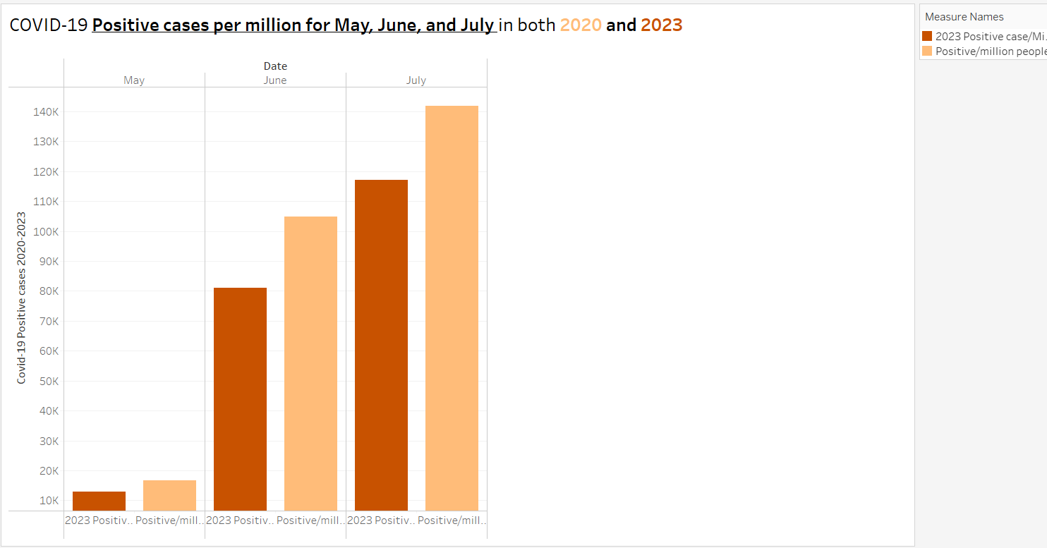

Slide 39
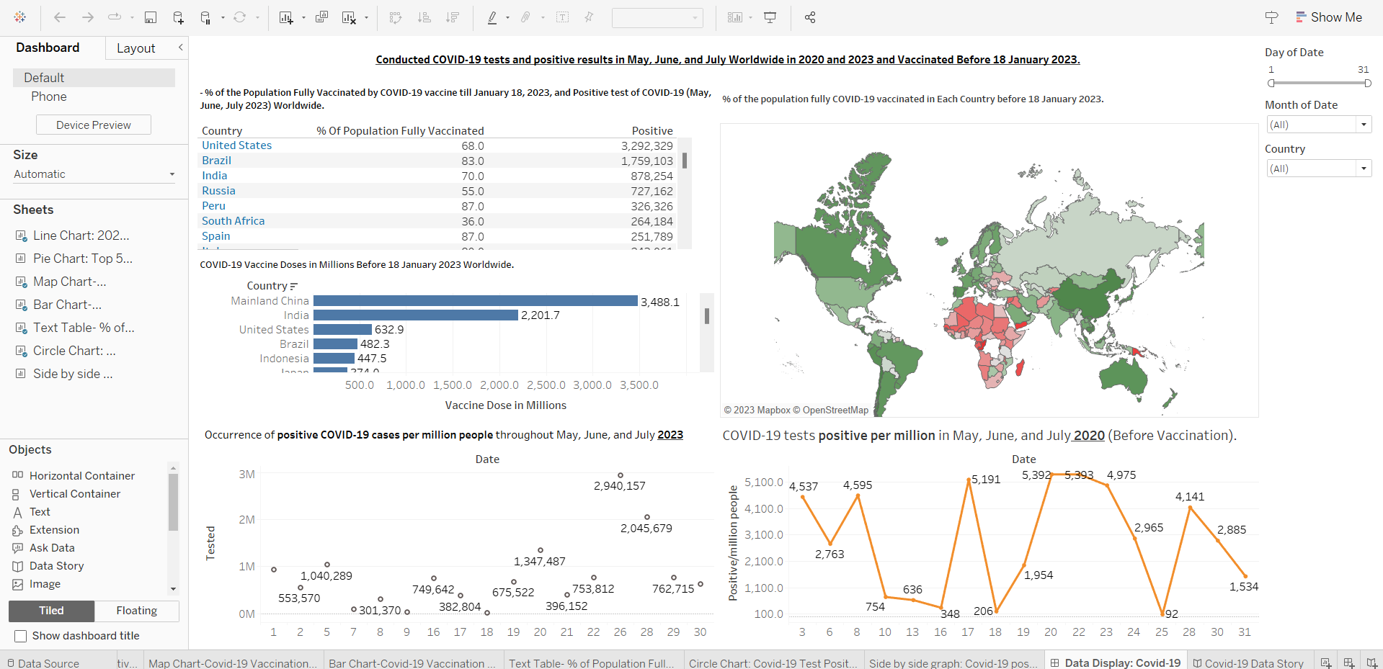
Dashboard
The dashboard offers a thorough summary of the dynamics of COVID-19 worldwide
It presents the percentage of the population who is fully vaccinated together with the associated positive instances in a tabular graph
A line chart shows the rise or fall of positive cases per million, whereas a bar chart shows vaccination intensity per million
Filters improve user interaction by allowing for customized data exploration by days, months, and nations.

Slide 40
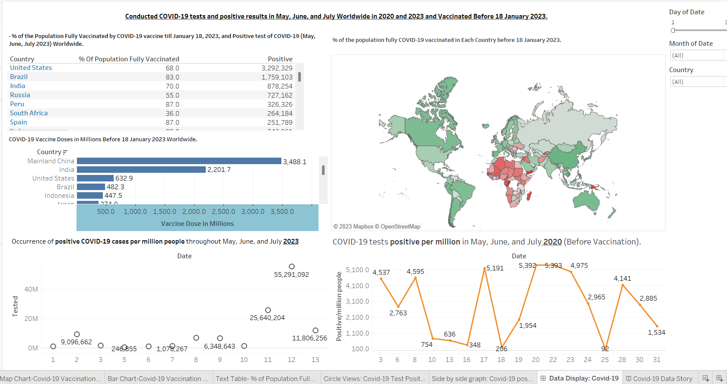

Slide 41
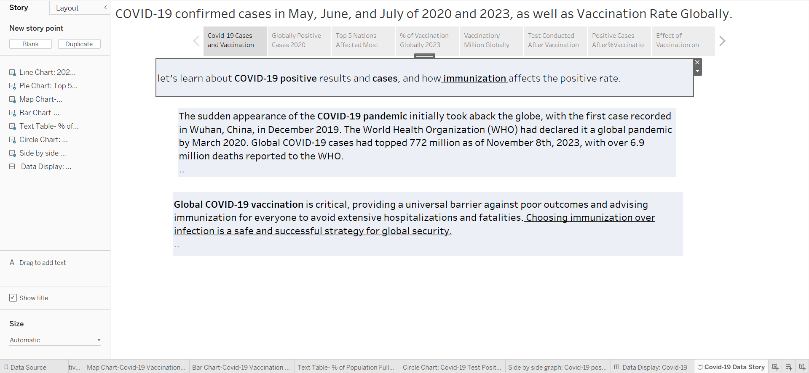
Tableau Story
Introduction
Let us learn about the effects of COVID-19 on the health of the world and how important immunization is to decrease its impact
The world was taken aback by the pandemic's unexpected appearance in December
By March 2020, the pandemic had been declared worldwide
Global immunization campaigns thus became essential, providing a universal safeguard against terrible repercussions and a plan for world security

Slide 42

Tableau Story
Summary of Tableau Story
The significant reduction in COVID-19-positive patients in 2023 as opposed to 2020 highlights the efficacy of widespread vaccination efforts
This decrease not only shows the benefits of immunization but also represents a significant achievement in the fight against the epidemic
There is optimism for less widespread virus transmission if countries prioritize immunization, which will strengthen the resilience of global health

Slide 43
Summary
We addressed 7 important pandemic-related subjects using a variety of graphical methods in our comprehensive COVID-19 data visualization project
Maps, tables, bar charts, circles graphs, comparison charts, and line graphs were some of the graphic aids used to highlight various facets of the pandemic
For quicker assessment, a graphic displaying the global coverage of the COVID-19 vaccine by January 18, 2023, was included
To understand the top 5 Countries affected by COVID-19 most during 2020 we can see through the picture chart
The percentage of fully immunized populations and the number of COVID-19 positive test results worldwide in May, June, and July of 2023 were displayed in a map graph

Slide 44

Summary
Changes over time were Visualized by a Circles graph that showed variations in COVID-19 Conducted cases each day During May, June, and July
The total doses of the COVID-19 vaccine/million people administered by each country before January 18, 2023, were compared using a horizontal bar chart
The text table graph explains how COVID-19 tests positive after being vaccinated in each country
The number of COVID-19 test-positive cases for May, June, and July 2020 and 2023 worldwide were displayed in a side-by-side comparison chart
Trends over time were highlighted by a line graph that showed variations in COVID-19-positive cases each day

Slide 45
Summary
The fact that there was a significant decrease in COVID-19-positive patients in 2023 as compared to 2020 is evidence of the efficacy of widespread immunization efforts
It is crucial to remember that immunizations benefit communities at large in addition to individuals
Those who are vaccinated can contribute to the protection of others who cannot, such as small children or those with specific medical conditions
Thus, to guarantee a safe and healthy future for all, it is imperative to support vaccination programs and raise public knowledge of their advantages

Slide 46
Conclusion
This effort skillfully presented essential details about COVID-19 vaccinations and testing using these several graphics
Valuable information about vaccination rates, infection patterns, and the interactions between these variables was supplied via maps, text tables, horizontal bar charts, side-by-side comparison charts, and line graphs
To fully understand the dynamics of the pandemic and make wise decisions, decision-makers, researchers, and the public need access to these graphic representations
They draw attention to gaps, connections, and patterns that might guide public health strategies and methods for dealing with the persistent problems brought on by COVID

Slide 47
References
SkyLord. (2020a, July 13). COVID-19 tests conducted by country. Kaggle. https://www.kaggle.com/datasets/skylord/covid19-tests-conducted-by-country
The New York Times. (n.d.). The New York Times. https://www.nytimes.com/by/josh-holder
Biswas, Md. R., Alzubaidi, M. S., Shah, U., Abd-Alrazaq, A. A., & Shah, Z. (2021, October 25). A scoping review to find out worldwide covid-19 vaccine hesitancy and its underlying determinants. MDPI. https://www.mdpi.com/2076-393X/9/11/1243
Platto, S., Wang, Y., Zhou, J., & Carafoli, E. (2021, January 29). History of the COVID-19 pandemic: Origin, Explosion, worldwide spreading. Biochemical and biophysical research communications. https://www.ncbi.nlm.nih.gov/pmc/articles/PMC7834510/
Young, L. J. (2023, August 13). Why are Covid rates increasing in the summer?. Scientific American. https://www.scientificamerican.com/article/whats-causing-the-late-summer-uptick-in-covid-hospitalizations/
Ryan, L. (2018). Visual data storytelling with tableau: story points, telling compelling data narratives. Addison-Wesley Professional.

Slide 48

Thank you

